Slide 1
Title
Author(s)
Affiliations of author(s)
9:16 ratio of Digital Poster Portrait Template
This template has been designed to show clearly within the digital poster screen and app that will be used for the Conference.
Please clear all text and objects on this template before designing your poster.
Your poster should include the following sections: Introduction, Materials & Methods, Results, and Conclusion.
We recommend you use standard system fonts such as Calibri, Verdana, Times New Roman, or Arial.
Recommended font sizes:
48-60pt for Titles/Headings
24-30pt for Text
You are limited to 1 slide within your digital poster.
Format should be submitted in PDF only.

Slide 2
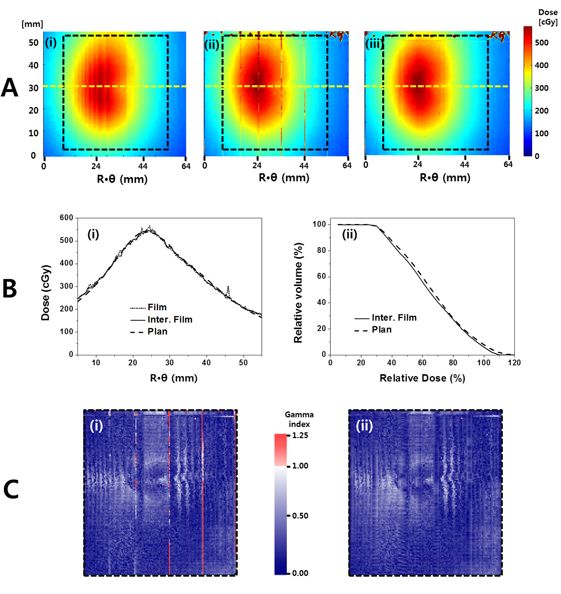
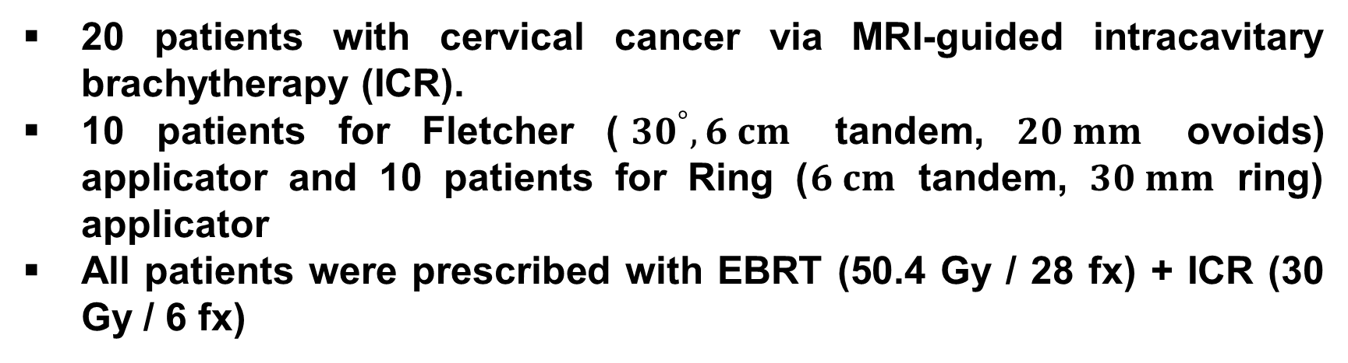
Dosimetric evaluation of an endorectal balloon
with radiochromic …
Young Goh¹, Soonki Min², Se Byeong Lee¹, Dongho Shin¹, Joo-Young Kim¹,
Dae Yong Kim¹ and Young-Kyung Lim¹
Proton Therapy Center, National Cancer Center, Goyang, Korea ¹,
Department of Radiation Oncology, Chosun University Hospital, Gwangju, Korea ²
ABSTRACT
Two-dimensional (2D) in vivo rectal dosimetry using an endorectal balloon (ERB) with an unfoldable
1. Introduction
3. Results
HDR brachytherapy for cervical cancer
Dose distributions & Gamma evaluations
High fraction size, e.g. 5 Gy/fraction or more
Steep dose gradient
Organs at risk (OAR) toxicity correlated to their volumetric dose, e.g. D(2 cm³)
Lack of image-guidance
Dose uncertainty due to applicator setup error, rectum and bladder variations, surrounding heterogeneous medium
Two-dimensional in vivo dosimetry having high resolution and Endorectal balloon (ERB) are needed to know the delivered dose accurately and to deliver the dose correctly!
2. Materials & Methods
Patient selection
20 patients with cervical cancer via MRI-guided intracavitary brachytherapy (ICR).
10 patients for Fletcher (${30}^{°}, 6 cm$ tandem, $20 mm$ ovoids) applicator and 10 patients for Ring ($6 cm$ tandem, $30 mm$ ring) applicator
All patients were prescribed with EBRT (50.4 Gy / 28 fx) + ICR (30 Gy / 6 fx)
Experimental setup
Ovoids
Tandem
10 mm
42 mm
2DD-ERB
4. Discussion
60 mm
CONCLUSION
The 2D in vivo rectal dosimetry using an ERB with an unfoldable EBT3 film is effective and valuable, and will be applicable for HDR brachytherapy for cervical cancer.
AOCMP 2026, Pusan, Korea

